Slide 1
Power Management on Linux Device Drivers

Slide 2
Agenda
1
Introduction to power management
2
Linux Kernel features for Power Management
3
A brief on Run time power management
4
Kernel-space applications focused on power management

Slide 3
Introduction to power management
The main aim is to consume as little power as needed for a specific configuration or use case.
Motivations
Reducing costs.
Extending battery life.
Decreasing heat.
Reducing environmental impact.
Challenges
Performance.
User experience.
Security and many more.

Slide 4
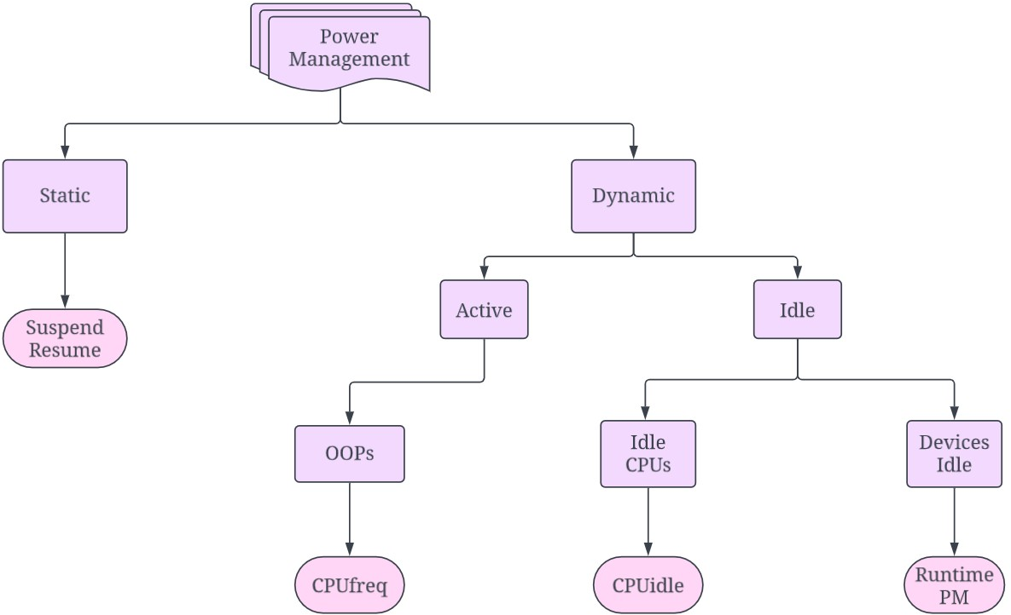

Power management in the Linux kernel
OPPs

Slide 5
Relationship between PM Core and Runtime PM
PM core manages the system-wide PM in Linux Kernel
Synchronizes Runtime PM and system-wide PM
kernel/power/
PM workqueue → pm_wq
Devices put their work items like suspend, resume, etc in the pm_wq
struct dev_pm_ops {
...
int (*runtime_suspend)(struct device *dev); int (*runtime_resume)(struct device *dev); int (*runtime_idle)(struct device *dev);
...
};

Slide 6


Relationship between PM Core and Runtime PM
A set of Runtime PM fields are provided by the power member of the device
structure
power.runtime_status power.use_autosuspend power.last_busy power.usage_count power.ignore_children power.deferred_resume
...
struct device {
struct dev_pm_info power;
}
Helper functions defined in drivers/base/power/runtime.c carries out Runtime PM operations with the help of PM core
PM Core
RPM Helper functions
Device Driver

Slide 7
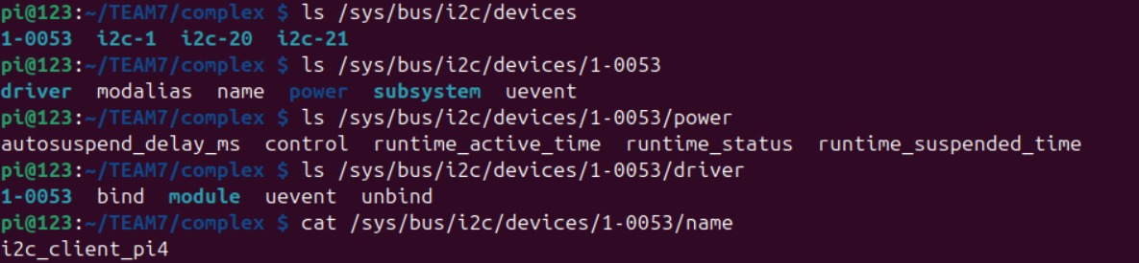
Drivers in I2C subsystems

Slide 8
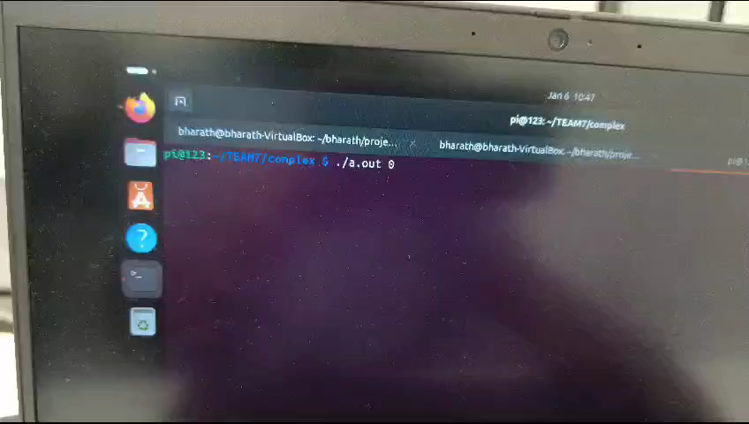

Slide 9

OUTPUT

Slide 10
THANK YOU

